Slide 1
Firework Simulation
By: Michael Lombardo

Slide 2

Firework Simulation Includes
Projectile Motion
Gravity is the only force acting on this system
Mass of firework decreases during flight, due to loss of fuel.
Collision Detection
Fireworks contain ‘tracker’ which will check the elevation of the firework
Firework’s elevation less than 250, firework will explode
Explosion sparks are checked for collision detection once released

Slide 3
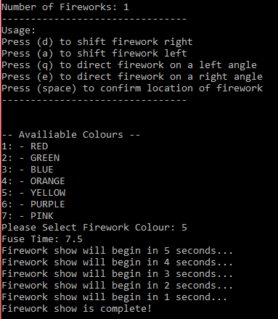
Text Based Interface
Users can select:
Firework count
Colour of firework
Fuse time

Slide 4
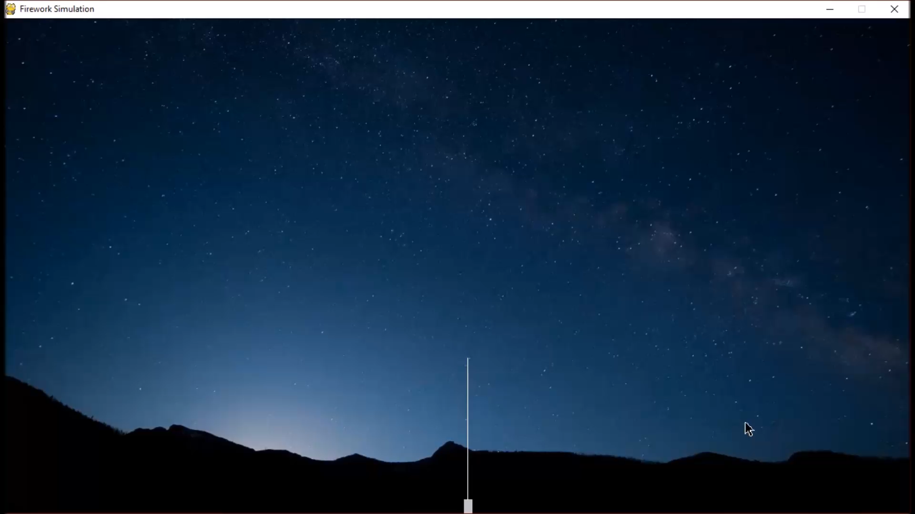
Stand Movement

Slide 5
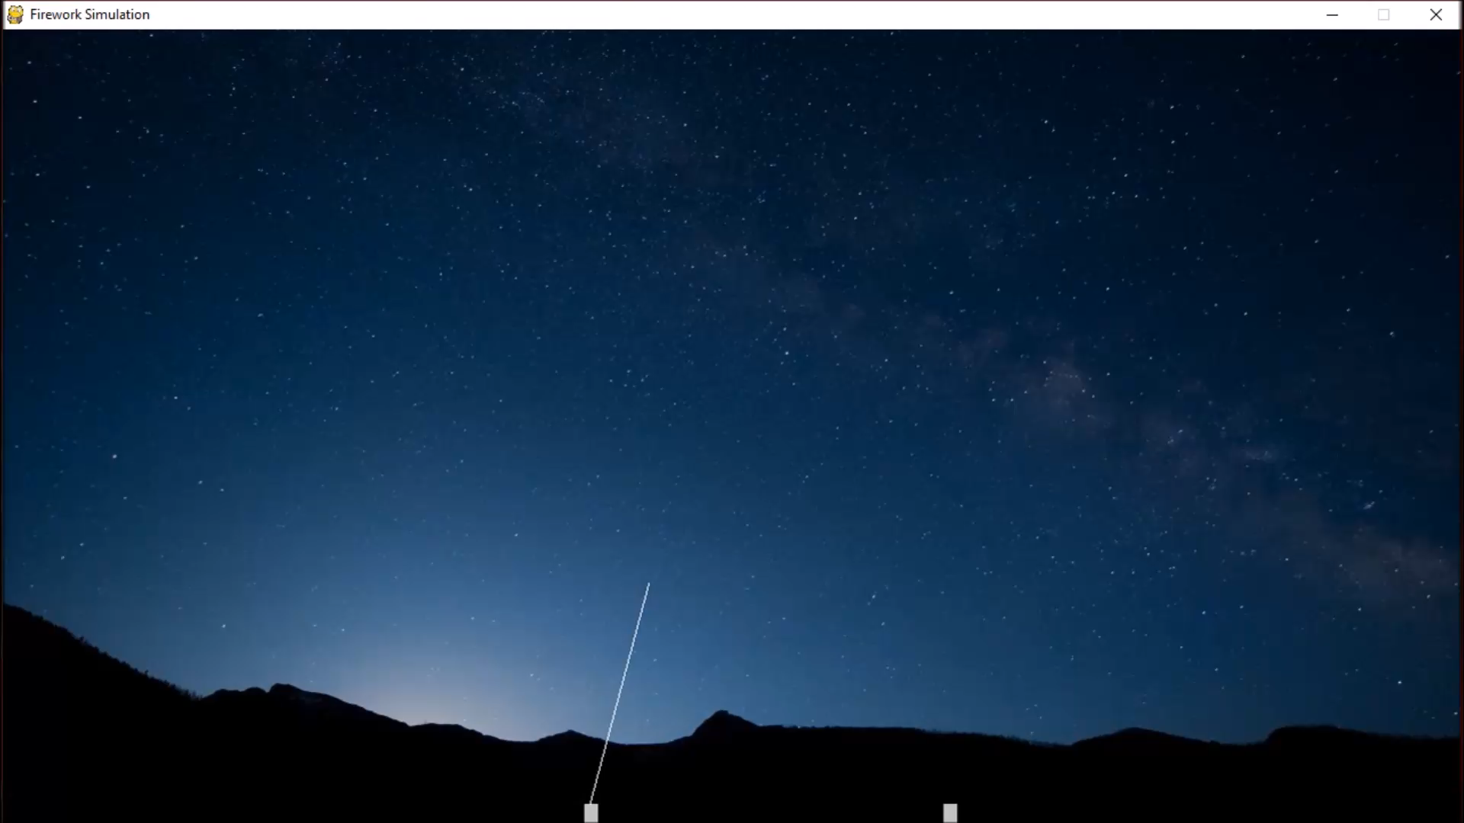
Elevation Technology Demonstration

Slide 6
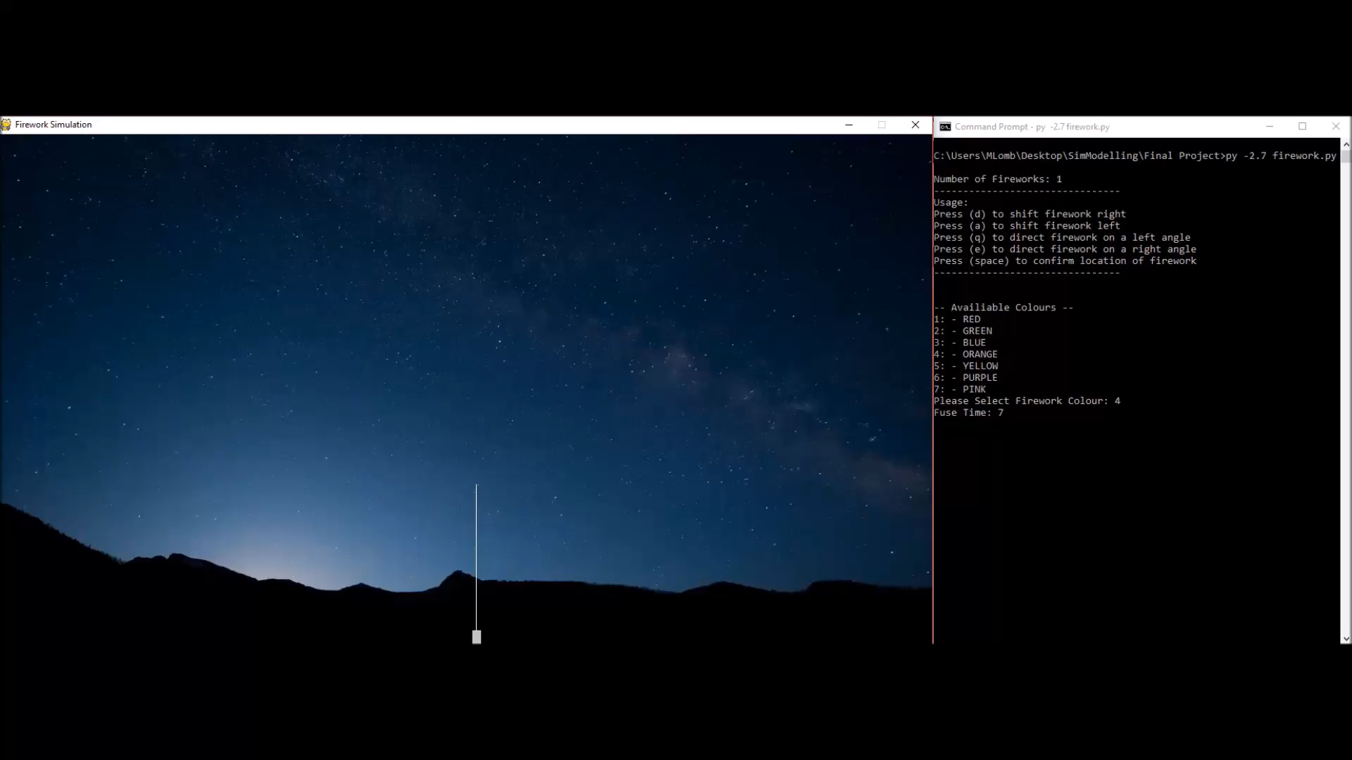
Full Demonstration

Slide 7
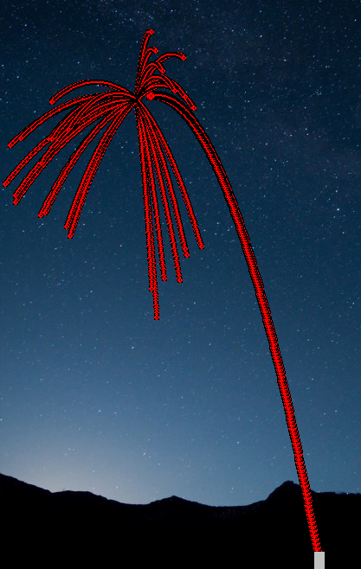
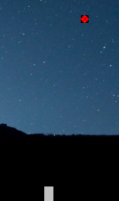
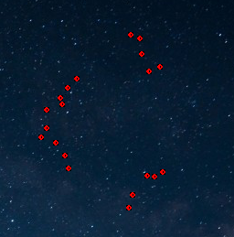
Challenges
Firework Sparks
Drawing Firework Tail
Outward velocities were evenly distributed over the four quadrants
Apply physics correctly vs. distributing the sparks perfectly even in a circle
Single firework circle vs. whole tail
Unable to refresh screen, due to delays in multiple fireworks and when their fuse is complete
Vs.

Slide 8
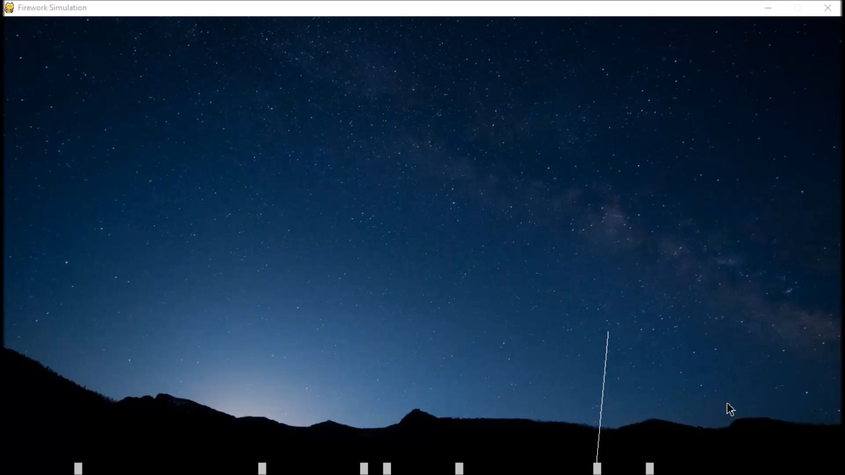
Multiple Fireworks Demonstration

Slide 9
Questions?

